Slide 1

Restaurant Visitor Forecasting
02/06/2018
Midterm Project
Name: Young, Brent
Predict 413 Section #: 55
Quarter: Winter 2018

Slide 2

Agenda
Data Exploration
Data Preparation
Types of Models
Formulation of Models
Performance/Accuracy

Slide 3
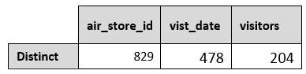
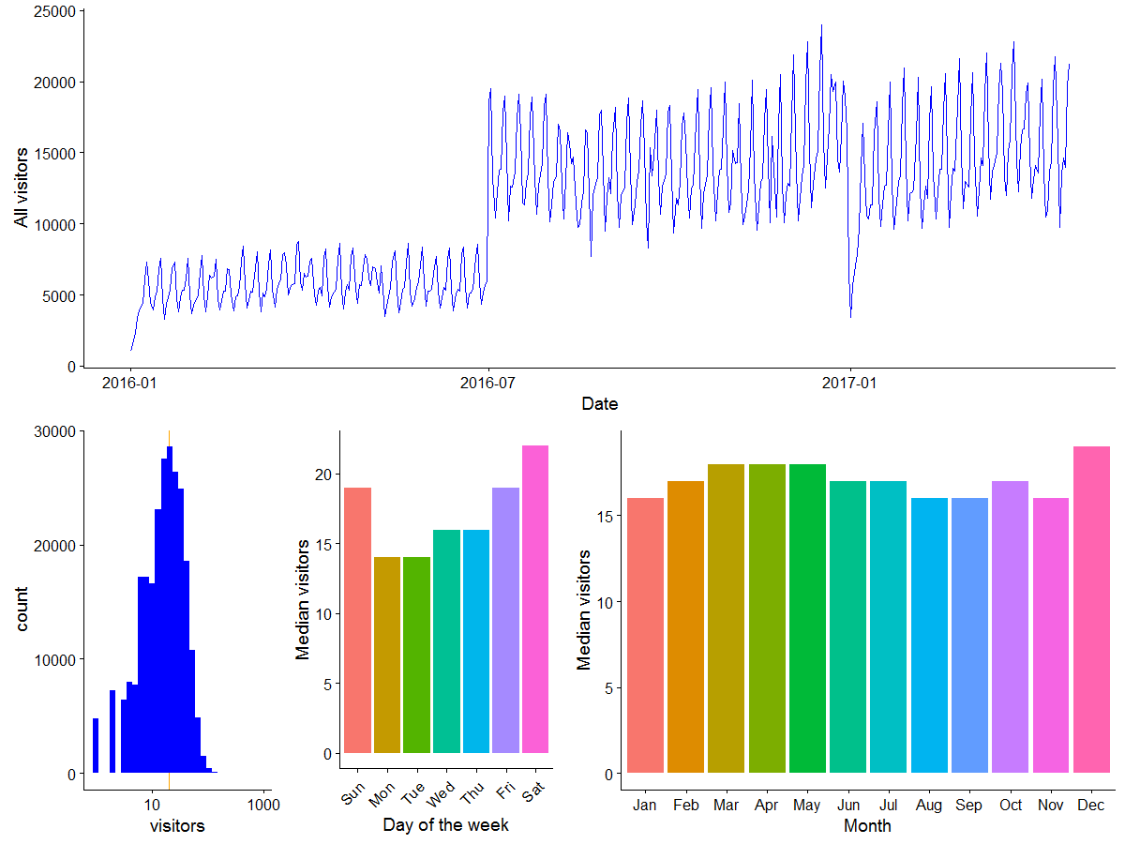

Data Exploration

Slide 4
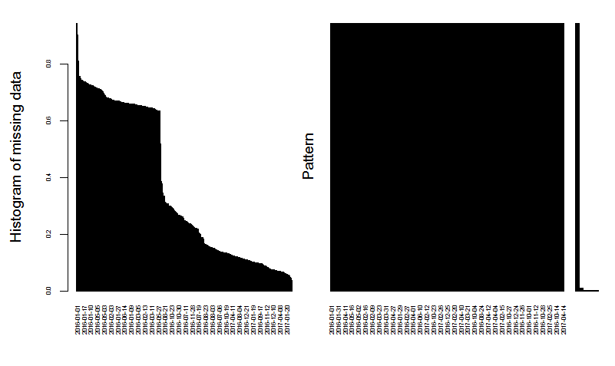
Data Preparation
Processing of Data: Reshaped/reformatted the dataset from long to wide format using the dcast function
Missing Values EDA
144,154 NA’s
Showed a downward trend from 2016 until April 2017
Appeared mostly from January to June 2016
NA’s steadily declined after June 2016
Coincides with the step level timeplot we saw earlier in our EDA
Imputation Approach
Filled missing values with 0
Reformatted visit_date to “mdy” format
January to June 2016
train_wide <- dcast(
air_visits, air_store_id ~ visit_date, value.var = "visitors")
June 2016 to April 2017
air_visits <- air_visits %>%
mutate(visit_date = mdy(visit_date))

Slide 5
Types of Models
Models: ETS and auto.arima
Data showed strong seasonality that corresponds to a weekly cycle
Both have the ability to handle seasonality
Estimate the necessary parameters
Select the appropriate model objectively for each individual time series based on AIC
Mixed Model Approach

Slide 6
Formulation of Models
Approach
Test our predictions for both auto.arima and ETS
Forecast for an individual restaurant (e.g., air_04341b588bde96cd) and then compare the results for this restaurant to other restaurants to see how these methods perform.
Train and test set:
Train: 1/1/2016 to 3/14/2017
Test: 3/15/2017 to 4/22/2017 (39 days) to mimic the period from 4/23/2017 to 5/31/2017 (39 days).

Slide 7
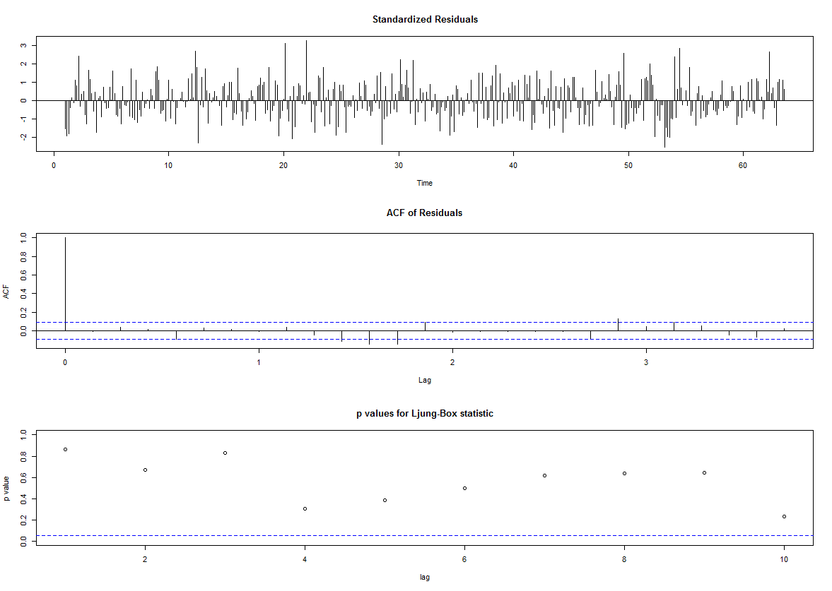
Auto.arima: ARIMA(1,0,0)(2,0,0)[7] with non-zero mean
KPSS Test for Level Stationarity data: diff(visits_train$visitors) KPSS Level = 0.0091844, Truncation lag parameter = 4, p-value = 0.1
Box-Ljung test data: residuals(arima.fit) X-squared = 12.825, df = 7, p-value = 0.07649

Slide 8
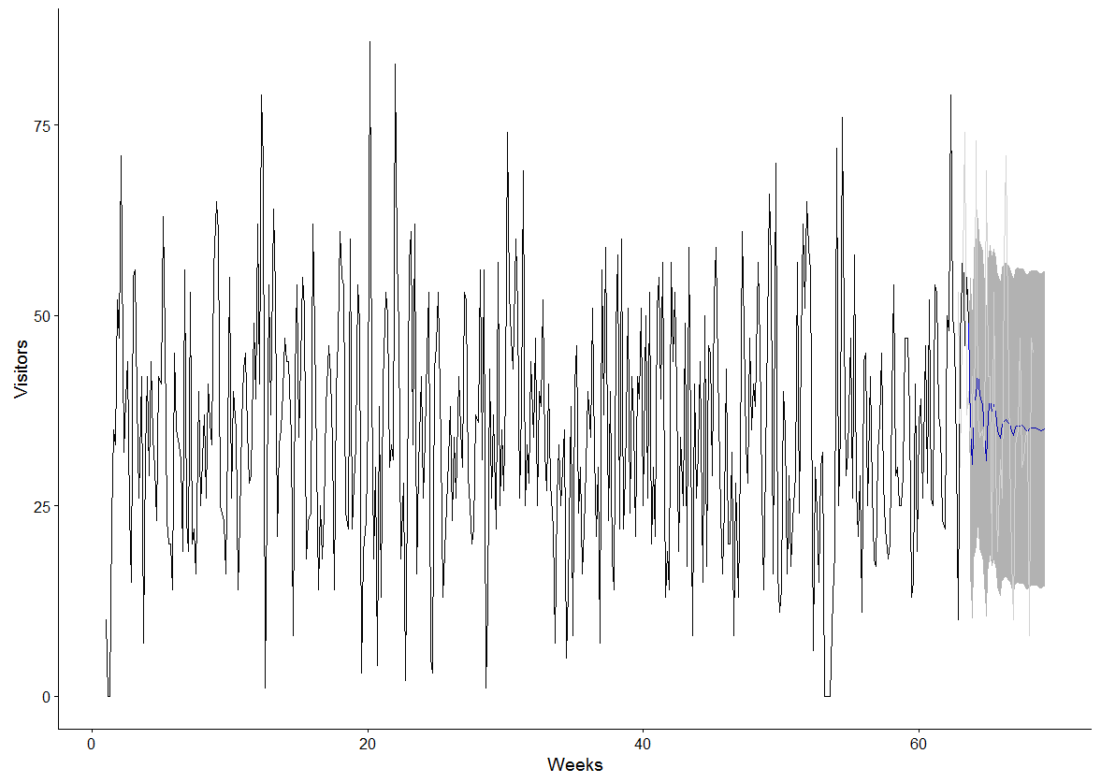
Auto.arima: ARIMA(1,0,0)(2,0,0)[7] with non-zero mean

Slide 9
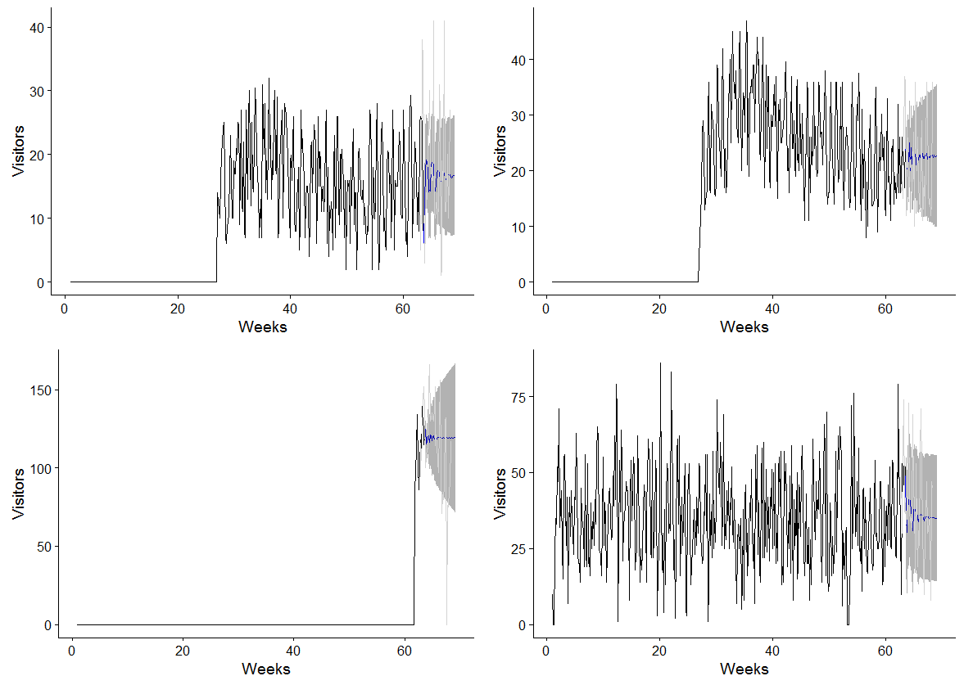
Auto.arima: ARIMA(1,0,0)(2,0,0)[7] with non-zero mean

Slide 10
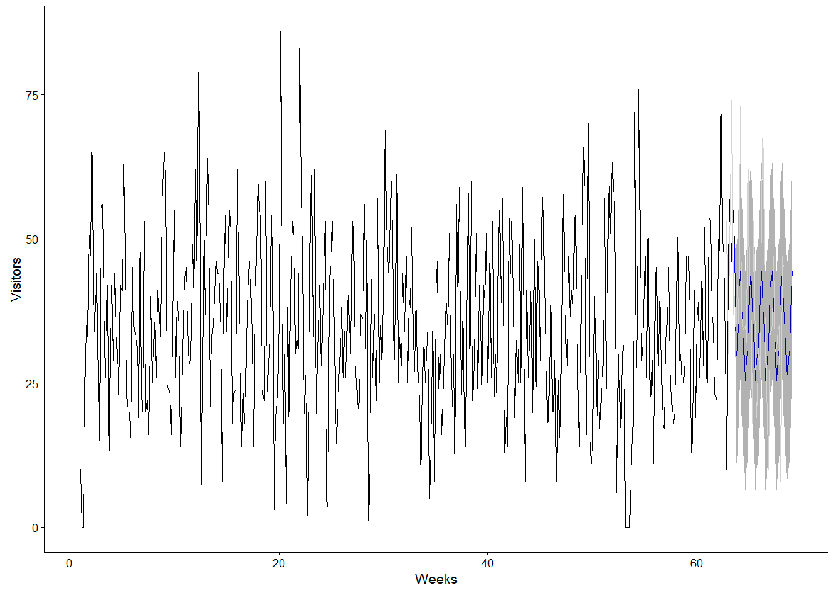
ETS: ANA Model

Slide 11
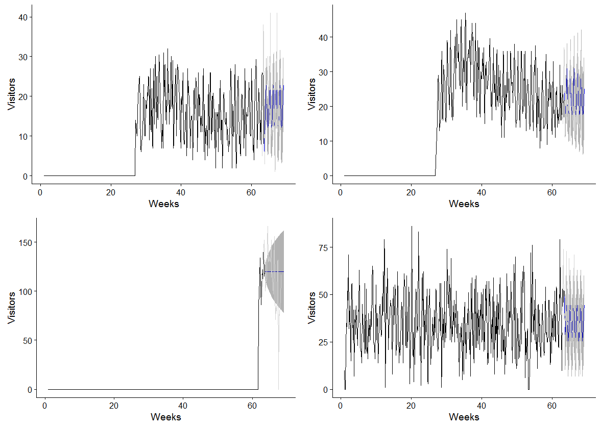
ETS: ANA Model

Slide 12
MIXED Model
Reasoning:
ETS and auto.arima model produced somewhat different results and are diverse
Ensemble Modeling Approach
Take the average forecasted visitors from the two models (auto.arima and ETS).
Benefits:
Create a more stable, robust, model that would improve my predictions and accuracy.
Similar to diversifying a stock portfolio

Slide 13
MIXED Model
R Code Process:
Changed the date format using mutate
Reshaped the dataset from long to wide using dcast
Creating a time series on the train data and a forecast interval of 39 days.
Created a matrix for the models
Used parallel processing (DoMC)
Created the forecasts and applied it to all 829 restaurants
Post processed the forecast table
Changed the forecast data frame back from wide to long format for final submission
Processed the sample submission file
Code Snippet:

Slide 14
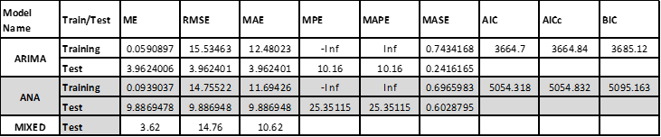
Performance/Accuracy
Accuracy Metrics for air_04341b588bde96cd
Figure 11: RMSLE for all 829 restaurants

Slide 15
Thank you!

